Slide 1
Optimization Stock Market Subteam
Optimization Team:
Yalini Senthil Kumar
Johnny Maroun
Josh Reno
James Rick
Napa (Tan) Vananupong

Slide 2
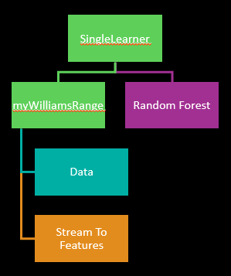
Problem Description
Buy/Sell binary classification using General Electric (GE) stock data.
Technical indicators as feature construction

Slide 3
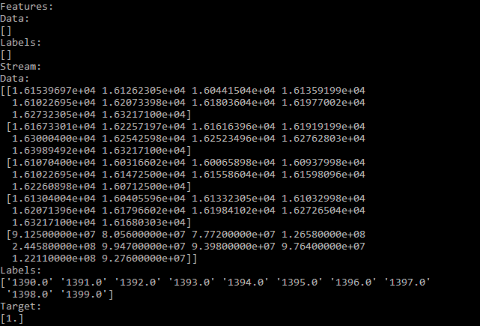
Initial Dataset Structure
For each instance of the dataset we are using 60 days of GE stock data, where each day has a value for the Open, High, Low, and Close price of the stock as well as the Volume traded on that day.
The class to predict is 1/0 and it is created by assigning 1/0 to instances where the 60th day of the stream is less than/greater than the 61 day of the stream.
We then split the data into 5 folds for cross validation, over the entire 60 years of GE data.

Slide 4
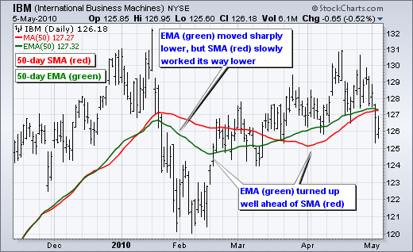
What’s an indicator?
Technical indicators focus on trading data rather than the fundamentals of a business. They are used to analyze short-term changes in stock prices.
Simple Moving Average (SMA) is the average of closing prices across a specific window length, normally around 15 days. A longer window length is slow to react to market changes while a smaller window is quick to react.

Slide 5
Currently Implemented Indicators
Bollinger Band
Aroon
Acceleration Band
Ease of Movement
Fast Stochastic
Average True Range
Money Flow Index
Price Channel
Commodity Channel Index
Triple Exponential Moving Average
Moving Average Convergence-Divergence
Chande Momentum Oscillator
Rate of Change
Rate of Change Rate
William’s % Range
Force Index
Linear Regression
Momentum
On Balance Volume
Volume
Simple Moving Average
Exponential Moving Average
Average Directional Movement
Feature Normalizer
Stock Normalizer
Relative Strength Index

Slide 6
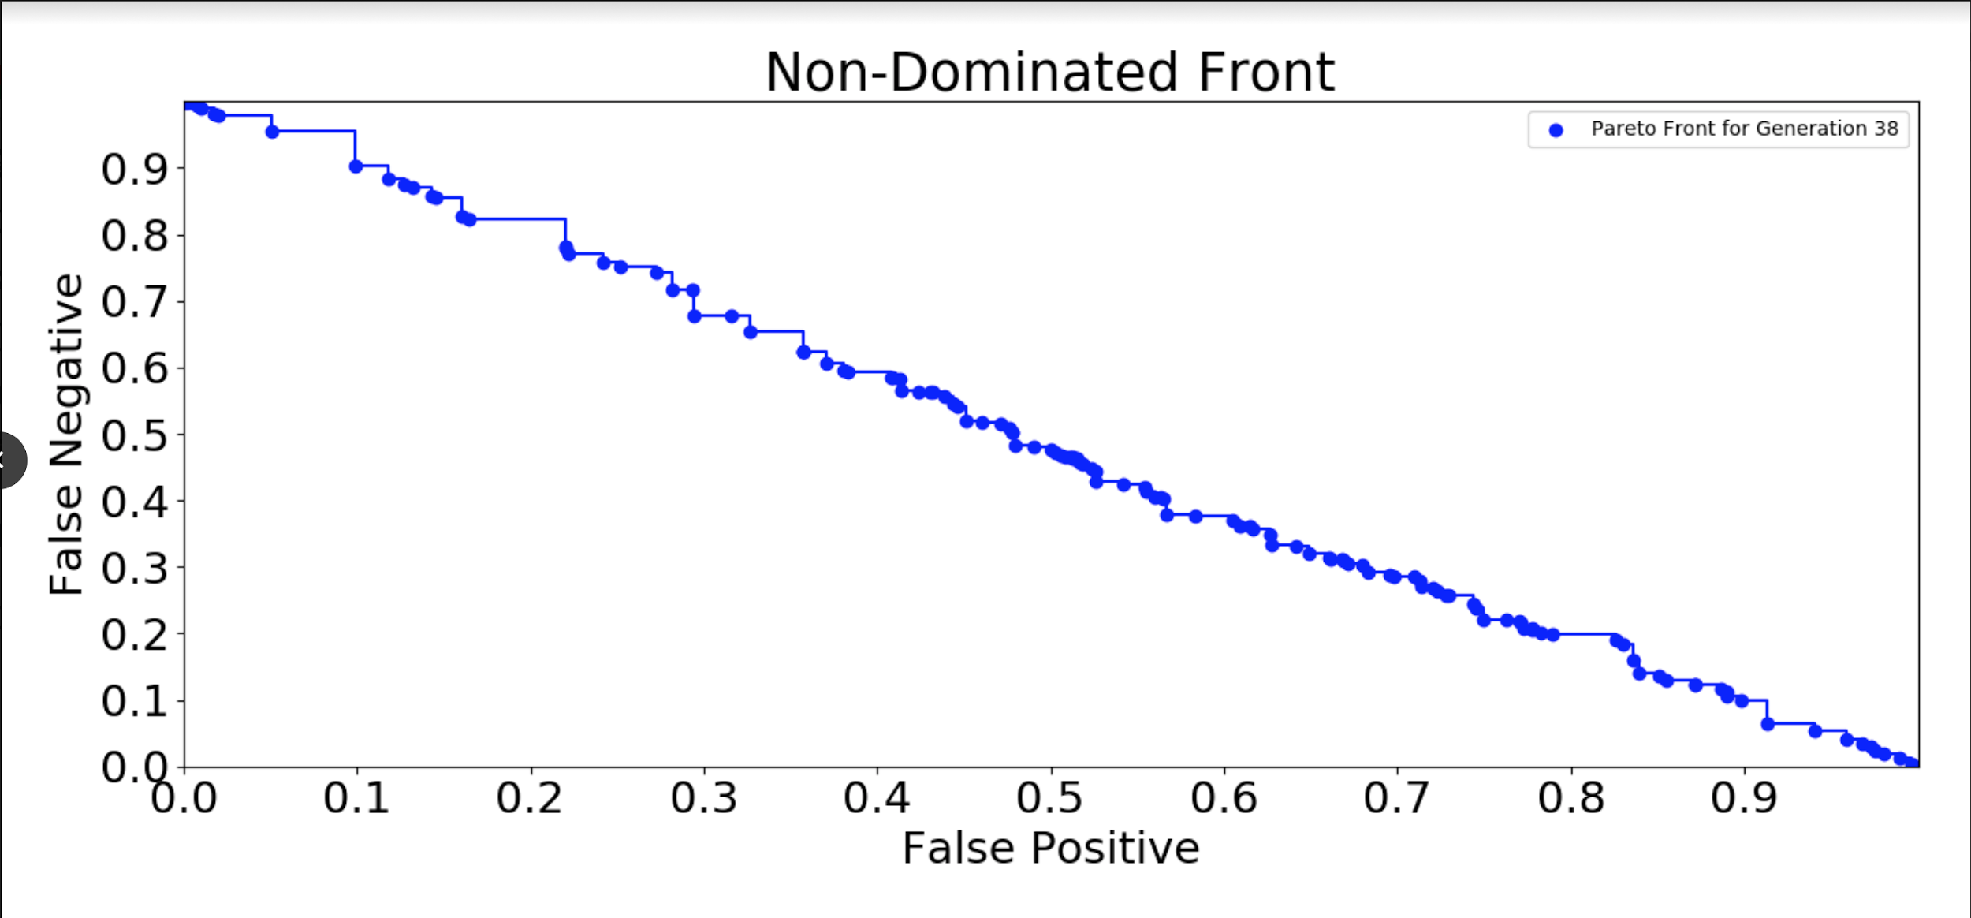
Failed Non-Dominated Front
Individuals in the Non-Dominated Front exist on line which means the individuals are performing 50/50 random guesses for the Buy/Sell classification.
Notes:
This is the normalized, non-dominated front of our original mid-semester run, granted the number of generations was very small at 38, but this visually shows the stagnation of individuals on the front effectively attributing the binary classification specific problem to chance alone

Slide 7
Why this structure failed
Indicators
Nature of many feature construction individuals was wrong/not robust in describing the data
No parameters to manipulate the technical indicators’ mathematical nature (feature length, lookback period, etc…)
Dataset
Prediction next day movements is extremely noisy
Some of the test folds came before the training data temporally
Data instances crossed over different market types
Notes:
Prediction of next-day movement noisy- volatile to the point of no generalization day after
Test folds before training data- periods of time where we trained on a single year, then testing on a different time period that didnt sequentially follow
Data instances crossed over different market types- training and testing over bear/bull markets mixed which effectively leads to wrong validation

Slide 8
Changed Dataset Structure
Each fold was formed from four years of data, 3 for training and 1 following year for testing.
The folds were constructed from the years 2009 to 2017 with a 1 year shift of the 4 year start time between folds.
Each fold contains an 50/50 distribution of buy/sell classes.
Training and testing folds in the bull market
Train_0: 09/01/2009 - 09/04/2012
Test_0: 09/05/2012 - 09/04/2013
Train_1: 09/01/2010 - 09/03/2013
Test_1: 09/04/2013 - 09/02/2014
Train_2: 09/01/2011 - 09/02/2014
Test_2: 09/03/2013 - 09/01/2015
Train_3: 09/04/2012 - 09/01/2015
Test_3: 09/02/2015 - 09/01/2016
Train_4: 09/03/2013 - 09/01/2016
Test_4: 09/02/2016 - 09/01/2017
Training/testing in a single market type is important since the machine learning algorithms may fit to noise if trained in a bear market, but applied to a bull market.
Predicting next movements is too noisy, so we want to predict a longer movement, so we predict the movement 10 days later.
Notes:
5 Train/Testing folds with 4-year windows of 3-year training periods and 1-year consecutive testing periods (75-25 split), as well as predicting an upward/downward trend when the last closing price of the 60-day window is compared with the closing price of the stock 10 days later

Slide 9
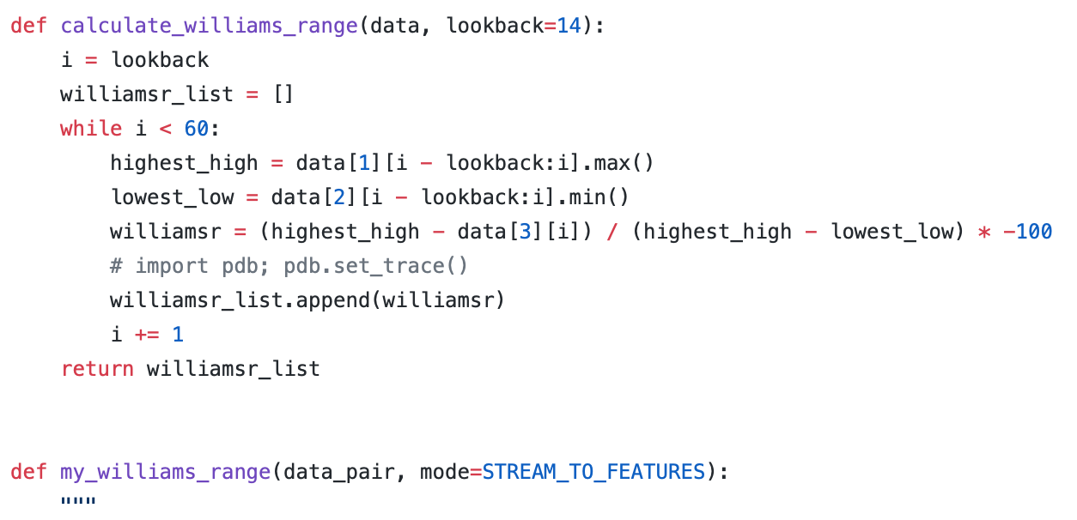
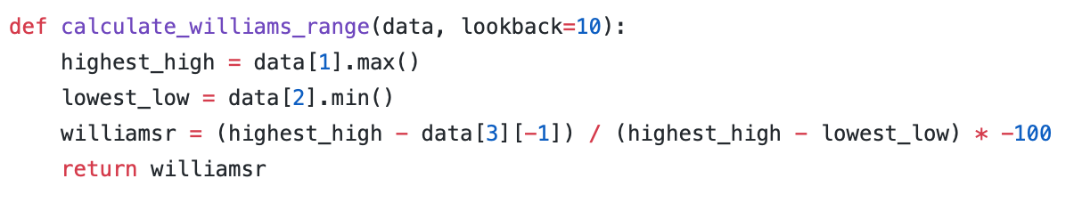
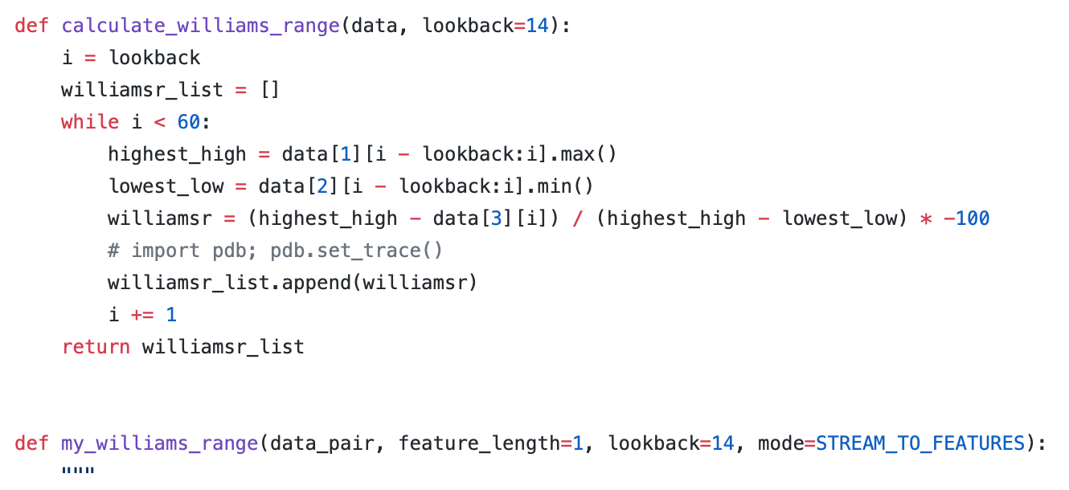

Changed indicators
Williams Range is a indicator that is the inverse of the Fast Stochastic Oscillator. Also referred to as %R, Williams %R reflects the level of the close relative to the highest high for the look-back period.
%R = (highest high - close) / (highest high - lowest low) * -100

Slide 10
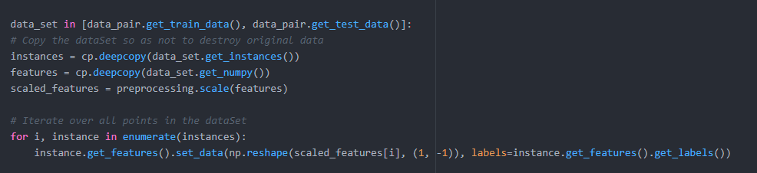
Feature Normalizer
Implemented a primitive to normalize each of the features with mean of 0 and standard deviations of 1.
This scales features to a similar range between -1 and 1 so that they are more comparable when the machine learning algorithm trains on them.
There was an error during construction of this primitive. The train folds and test folds are normalized individually, we should be normalizing with respect to the training folds mean and standard deviation.
Notes:
Normalizes the features that were constructed from the indicators using the stream data that was input.

Slide 11
Seeded Individual
Seeded Individual Fitness: (False Positives, False Negatives, Tree Size)
(53.6, 28, 232)
Accuracy: 54.3%
Seeded Individual String:
SingleLearner(myFeatureNormalizer(myClose(myOBV(myVolume(mySMA(myEMA(myEMA(myADX(myMomentum(myMomentum(myRocr(myRocr(myWilliamsRange(myLinearRegression(myLinearRegression(ARG0, 1, 20, 2), 1, 10, 2), 1, 14, 2), 1, 12, 2), 1, 3, 2), 1, 3, 2), 1, 1, 2), 1, 14, 2), 1, 12, 2), 1, 6, 2), 1, 3, 2), 1, 2), 1, 2), 1, 2), 0), learnerType('Trees', {'criterion': 0, 'splitter': 0}))
Indicators for the seed were taken from:
Xinjie Di, Stock Trend Prediction with Technical Indicators using SVM

Slide 12

Non-Dominated Front

Slide 13
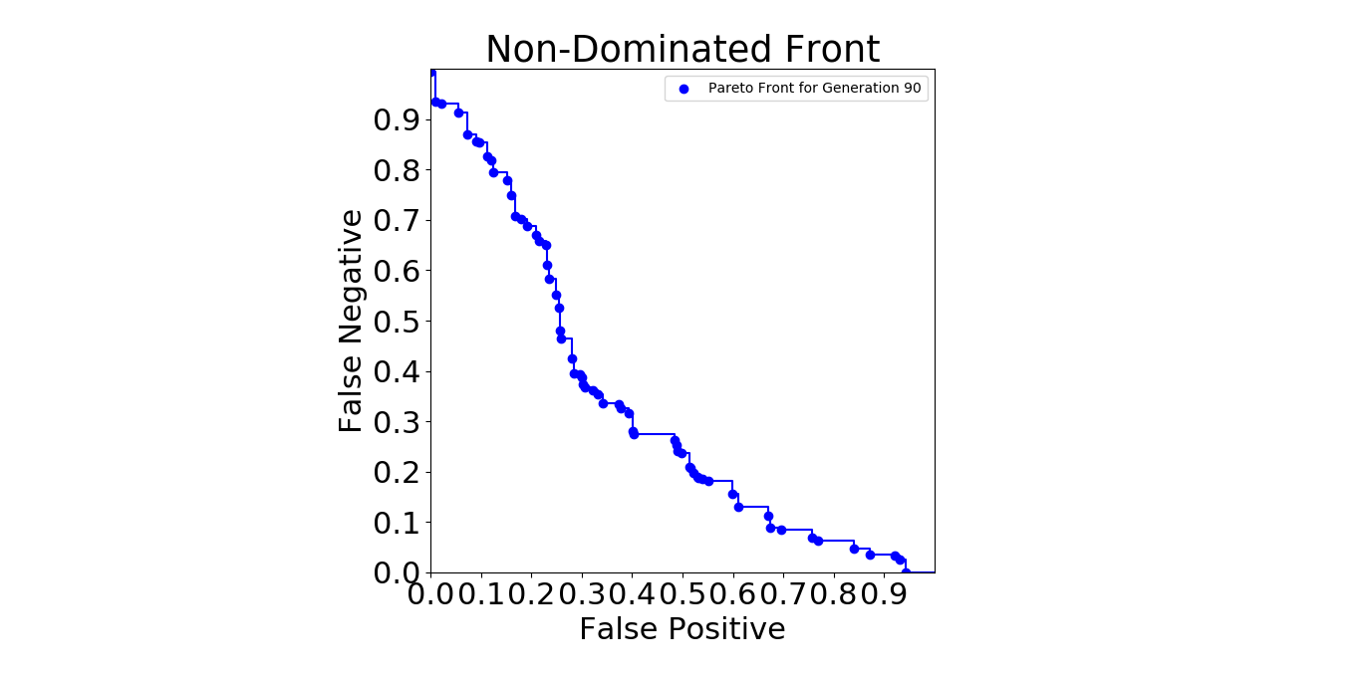
Non-Dominated Front
6808 Individuals were evaluated over 90 generations, Non-Dominated Front.
292 Individuals in the final Non-Dominated Front

Slide 14
Non-Dominated Individual
Non-Dominated Individual Fitness: (False Positives, False Negatives, Tree Size)
(31, 30.4, 228)
Accuracy: 66%
SingleLearner(myFeatureNormalizer(myClose(myVolume(myClose(myOBV(mySMA(myEMA(myEMA(myMomentum(myMomentum(myRocr(myWilliamsRange(myLinearRegression(ARG0, passTriState(passTriState(1)), 11, 1), 2, 13, 2), 0, 64, 2), 0, 3, passTriState(passTriState(2))), 0, 0, 2), 1, 12, 2), 1, 14, 2), 1, 2, 2), 2, 2), 2, 2), 1, 2), passTriState(passTriState(passTriState(passTriState(2)))), 2), 0), learnerType('Bayes', None))

Slide 15
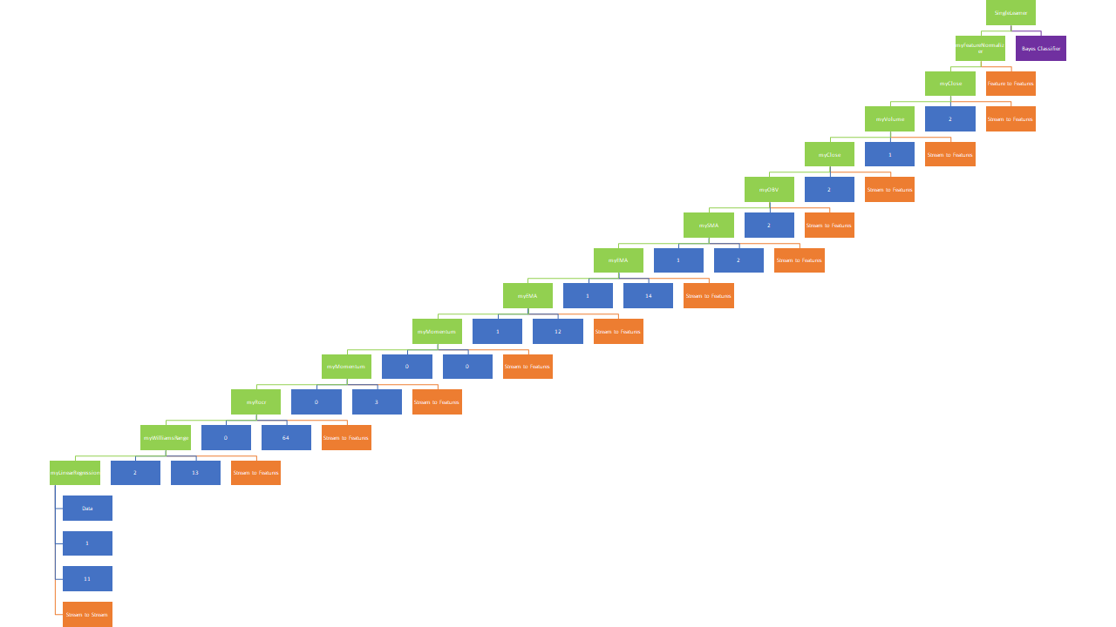

Slide 16
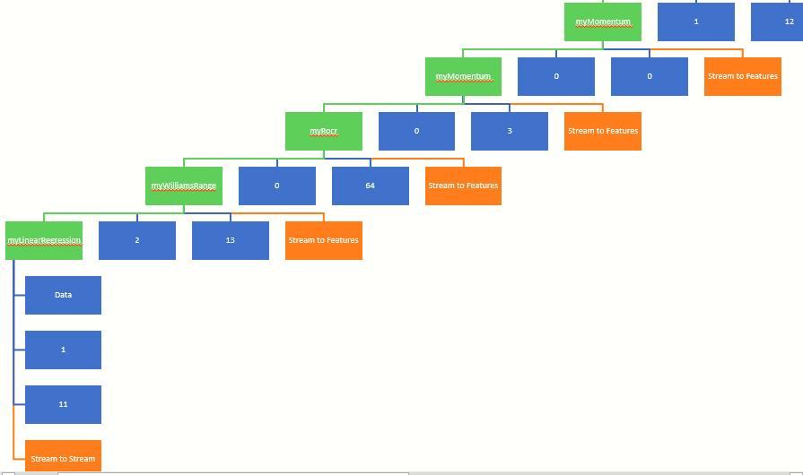

Slide 17
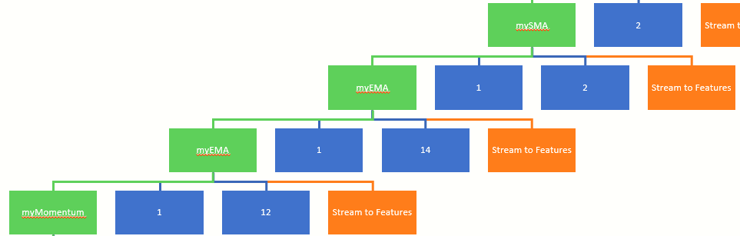

Slide 18
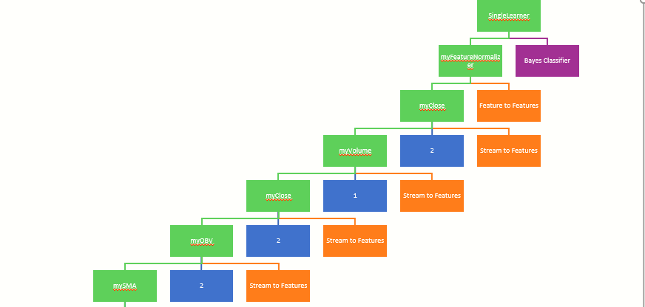
Pareto Individual

Slide 19
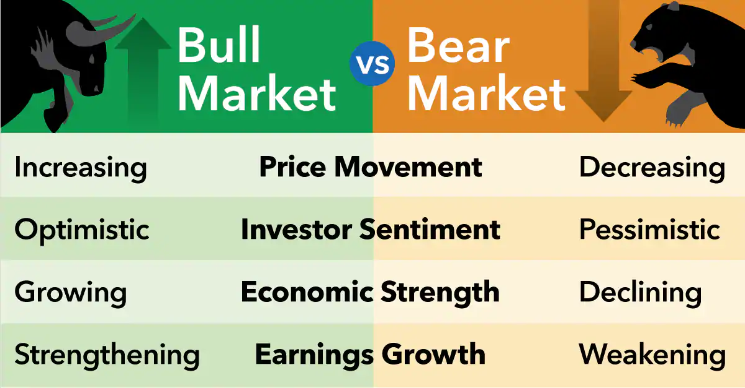
Going Forward
Bloat removal: remove unnecessary indicators
Testing on a bull market vs bear market
Iterative testing: predict every day, every five days etc. instead of every ten days
Run on out of sample validation set
Classification → Regression

Slide 20





Optimization
Yalini Senthil Kumar
Tan Vana
Johnny Maroun
Josh Reno
James
Rick

